Slide 1

Auto Finance
Presented By
Yagnesh Pansuriya (18012011054)
Dhruvesh Panchal (18012011050)
Anuj Patel (18012011060)
B.Tech C.E (8th Sem.)

Slide 2
01. ABOUT THE PROJECT
04. UML DIAGRAMS
02. SOFTWARE SPECIFICATIONS
05. CONCLUSION AND FUTURE WORK
03. PROJECT MODULES
06. OUR TEAM
Abstract, Introduction, Existing and proposed System
ER, Use case and class Diagram
Hardware and Software Specifications
Conclusion and future work of project
7 Various Modules and Screenshots of Our Projects
Team Members

Slide 3

OUR COMPANY

Slide 4
ABSTRACT
This project aims at creating an Auto Finance System which can be used by financers, dealers and their clients. It is a web-based application. This application is developed using HTML, CSS, AJAX, JavaScript and PHP. It uses MySQL database. Firstly, financer has to register clients details in this application. Clients have to provide their personal details such as full name, documents, vehicle details, phone number, address and one guarantor details. After the successful registration, client will able to pay their EMIs into this application by providing login credentials. Financer is able to view and update personal details of every client. Clients can check what amount is due of their vehicle and what portion of amount in the loan is paid. Clients can also download their payment reports. Apart from this, dealer is also able to manage if a client is delaying the EMIs and can fine penalty to them. On the other hand, They can contact admin immediately if they face any difficulties by using this web application. This project provides high security to financers, dealers and clients. Our personal purpose is to make the procedure of auto finance easier and faster for users.

Slide 5
INTRODUCTION
Nowadays, the users of the internet are growing at the speed of rocket all over the globe. In extra, internet has made everyone’s life more convenient and faster. So, every field in the world is growing faster in online as compare to offline. So, this web-based Auto Finance system will help financers and dealers to handle their Clients online. Interactive GUI and the ability to manage various activities will make this system very flexible and convenient. Any financer or a vehicle dealer is a very busy person and does not have the time to sit and manage the entire activities manually on paper. This application gives him the power and flexibility to manage their clients’ activities from a single online system. This system provides various facilities such as graphical status, payment management, view reports, SMS setting edit profile and many more. Admin has power to manage every professional thing of their Clients using this single system.

Slide 6
EXISTING SYSTEM
In the present system, all the facility is not available through Web Mode.
Too Many lapses and changing rates of EMI as per greediness of dealers and harder to manage through softwares.
Problems in Existing System
The foremost problem is that there are multiple price dispersion in different softwares and dealers selling vehicles.
Inconsistent Risk-Based pricing
Expensive Markups from Dealerships
Does not provide full analytics either they are more focused towards dealers or are in underuse.

Slide 7
PROPOSED SYSTEM
The proposed system is designed to overcome the problems in the Existing system.
Advantages of Proposed System
This Application is fully functional and flexible.
You can instantly call or contact the admin for any query.
It saves a lot of time and makes easier for dealers to lend or sell their vehicles easily.
There is no individual charges.
Less Time Consuming.

Slide 8





SOFTWARE SPECIFICATION
Xampp or Wamp Server
MySQL Database
Adobe Dreamweaver or Brackets
Browser – Chrome, Mozilla or any

Slide 9




HARDWARE SPECIFICATION
Operating System : Windows 7 or any high
An Intel Pentium 4 processor or later that's SSE3 capable
Minimum 4 GB RAM
Minimum 50 GB ROM

Slide 10
PROJECT MODULES
01
02
03
Admin Module
Customer Module
SMS Module
04
05
06
Payment Module
Showroom Module
Account and Setting Module

Slide 11
ADMIN MODULE
The Project Admin module allows administrators to add, update, delete clients. Admin can manage showroom payments and can manage profile. Moreover, view information about the remaining EMIs and how many months the loan will continue. In addition, admin can also view date wise information of payment, EMIs and also download different reports.

Slide 12
CUSTOMER MODULE
Clients can check what amount is due of their vehicle and what portion of amount in the loan is paid. Clients can also download their payment reports. Clients can check fine payments if they miss any EMI. In addition, They can contact admin immediately if they face any difficulties by using this web application.

Slide 13
SMS MODULE
This module helps admin to send text message to clients when the EMI date is near and also notify them if there’s a delay in paying the EMI as well as it can send messages related to festivals for greeting the clients.

Slide 14
PAYMENT MODULE
This module is for Payment gateway integration , User can pay their installments/ EMI through online portal such as Paytm, UPI as well as can deposit cheque to financer.
In addition, they can view their amount due to pay to dealer as well as months remaining to be completed before their EMI ends.

Slide 15
SHOWROOM MODULE
It determines the Data of the showrooms such as their contact information, address and pin code. Admin can view, update, delete showroom details and use all the data as per the needs.

Slide 16
SETTING MODULE
In this module admin can edit profile information such as logo, business name, business address, contact, and payment gateway details.
In addition, admin can change password of the admin section by providing old password.

Slide 17
UML DIAGRAMS

Slide 18
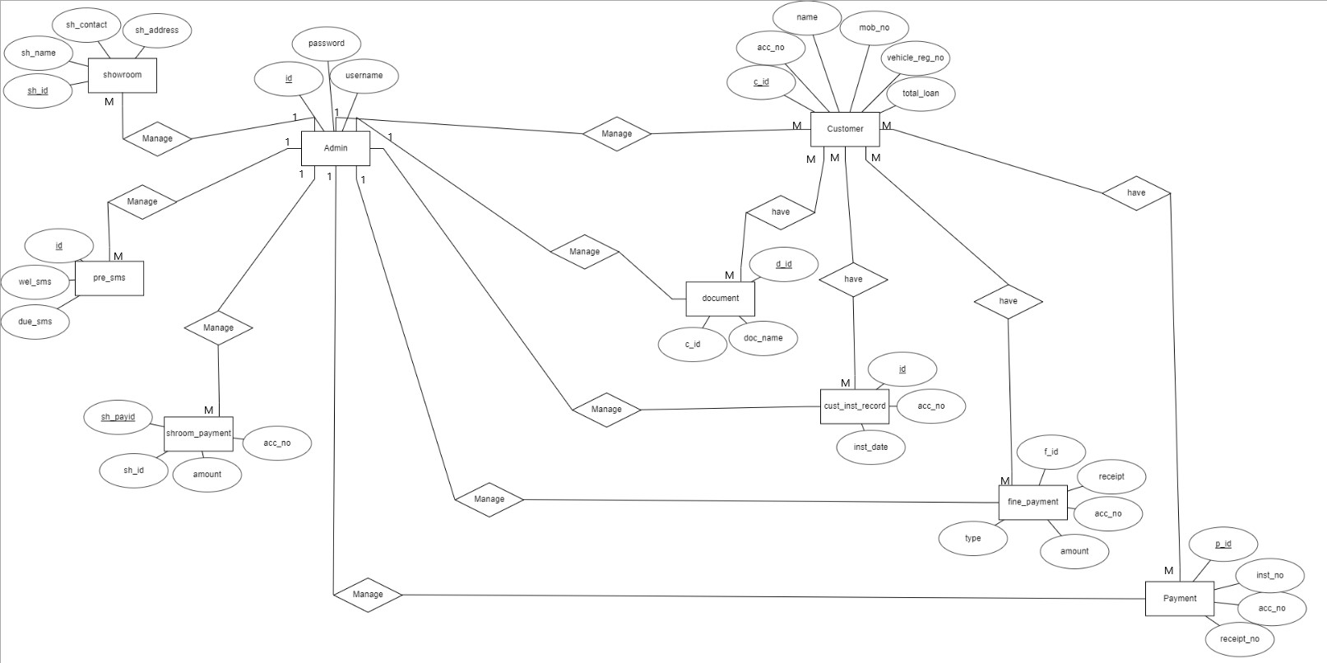
ER DIAGRAM

Slide 19
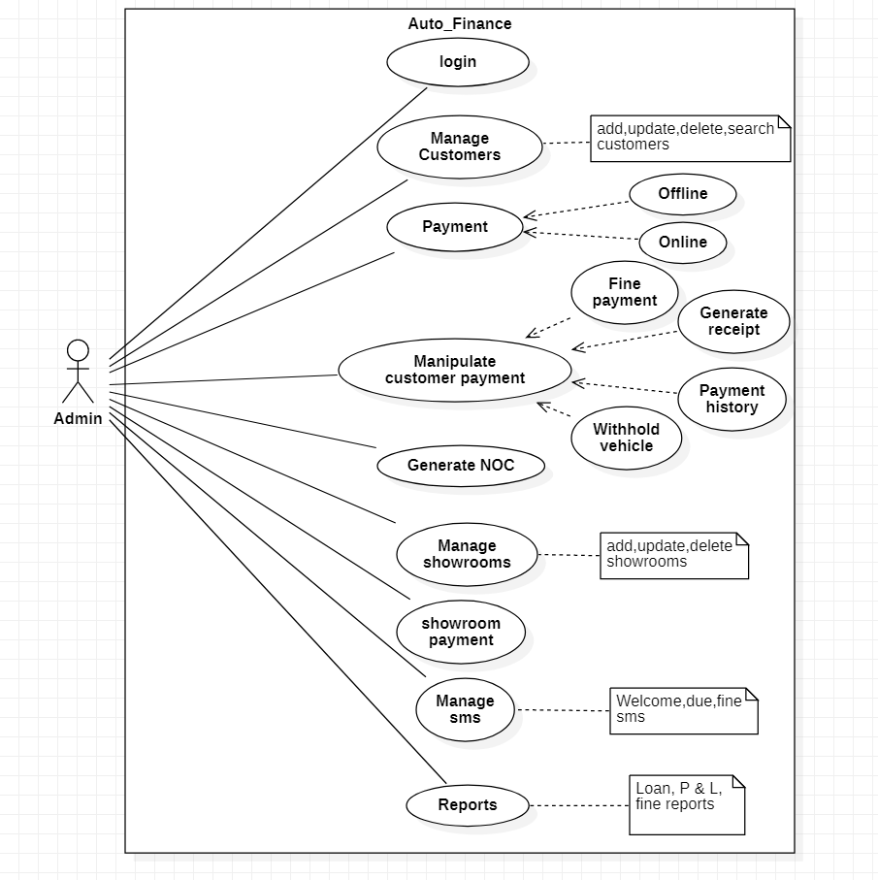
ADMIN USE CASE DIAGRAM

Slide 20
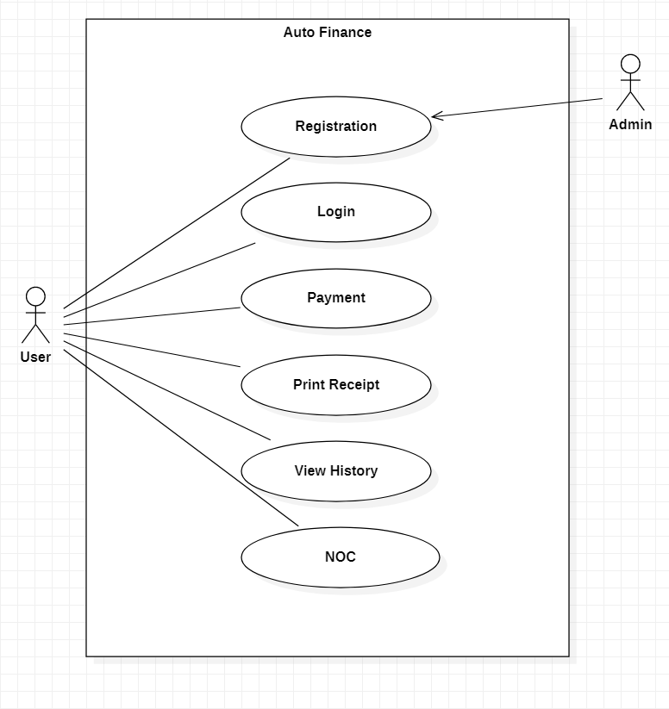
USER USE CASE DIAGRAM

Slide 21
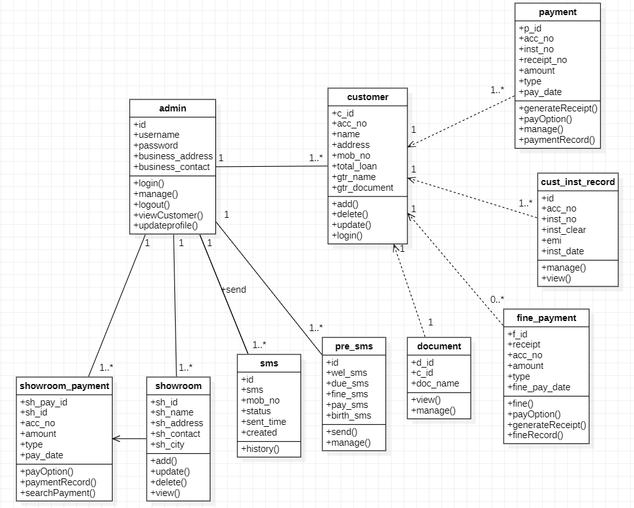
CLASS DIAGRAM

Slide 22
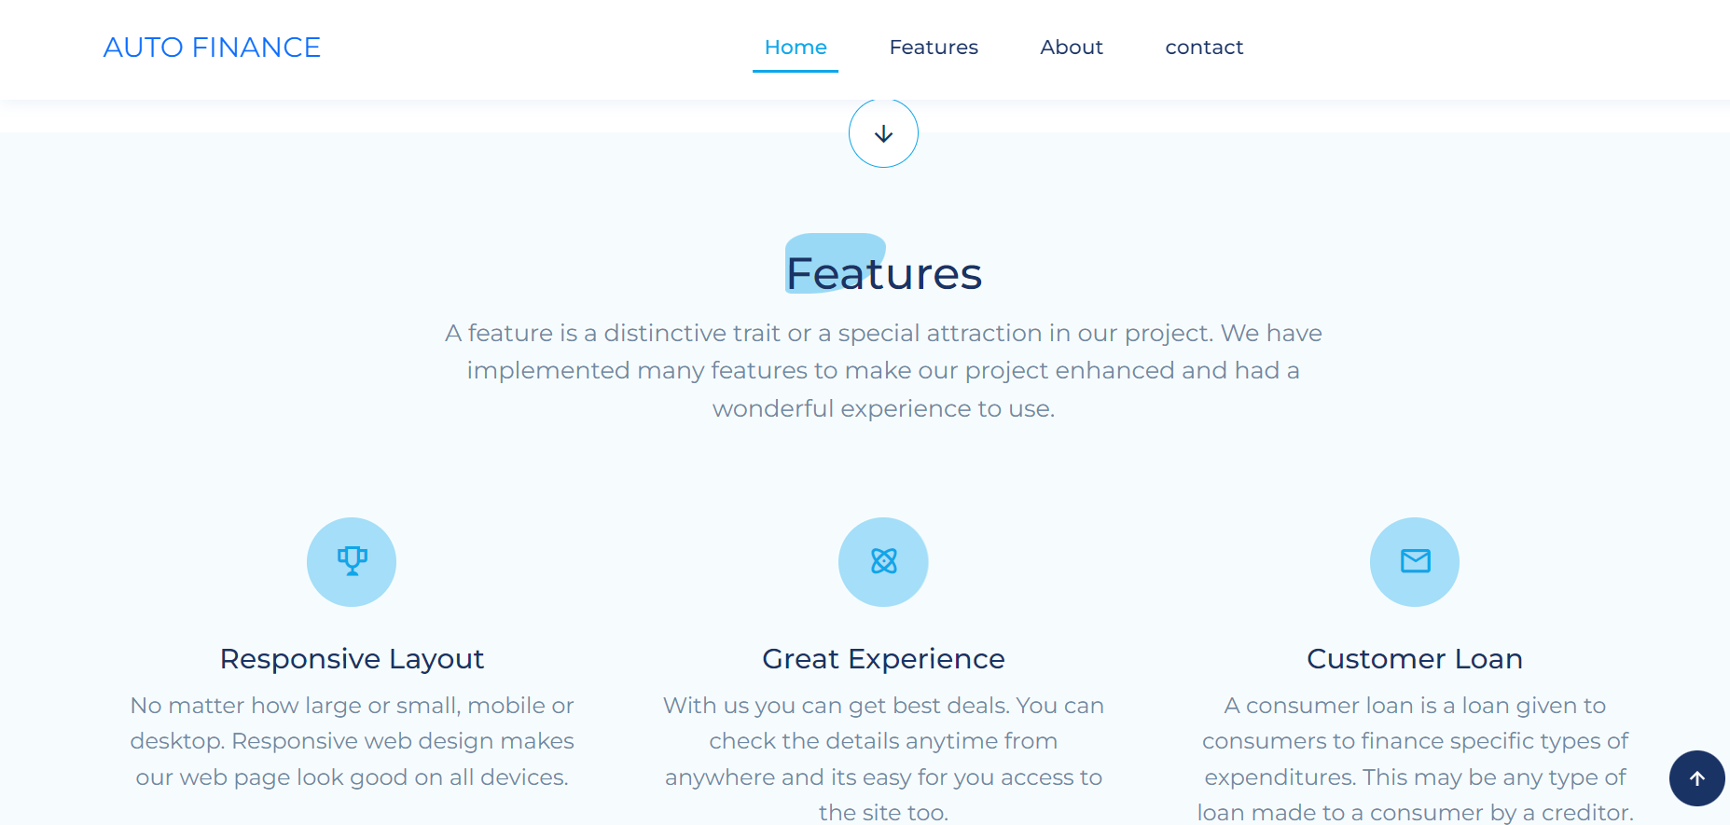
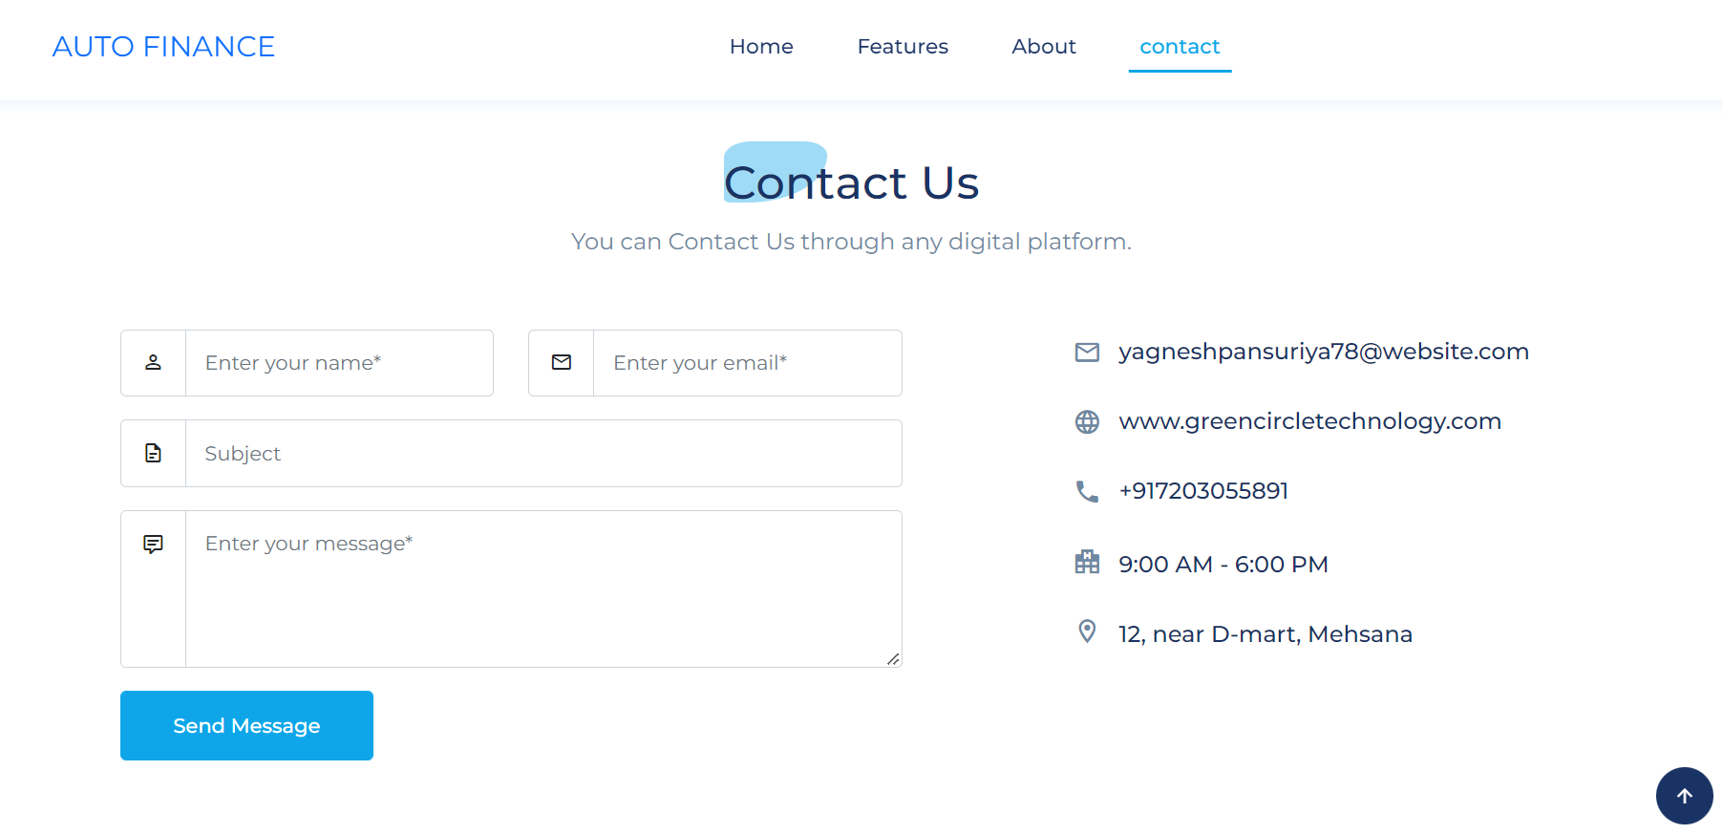
SCREENSHOTS
Contact Us section in home page :
From this section user can contact owners.
This page is home page of application where user can find overview of application.

Slide 23
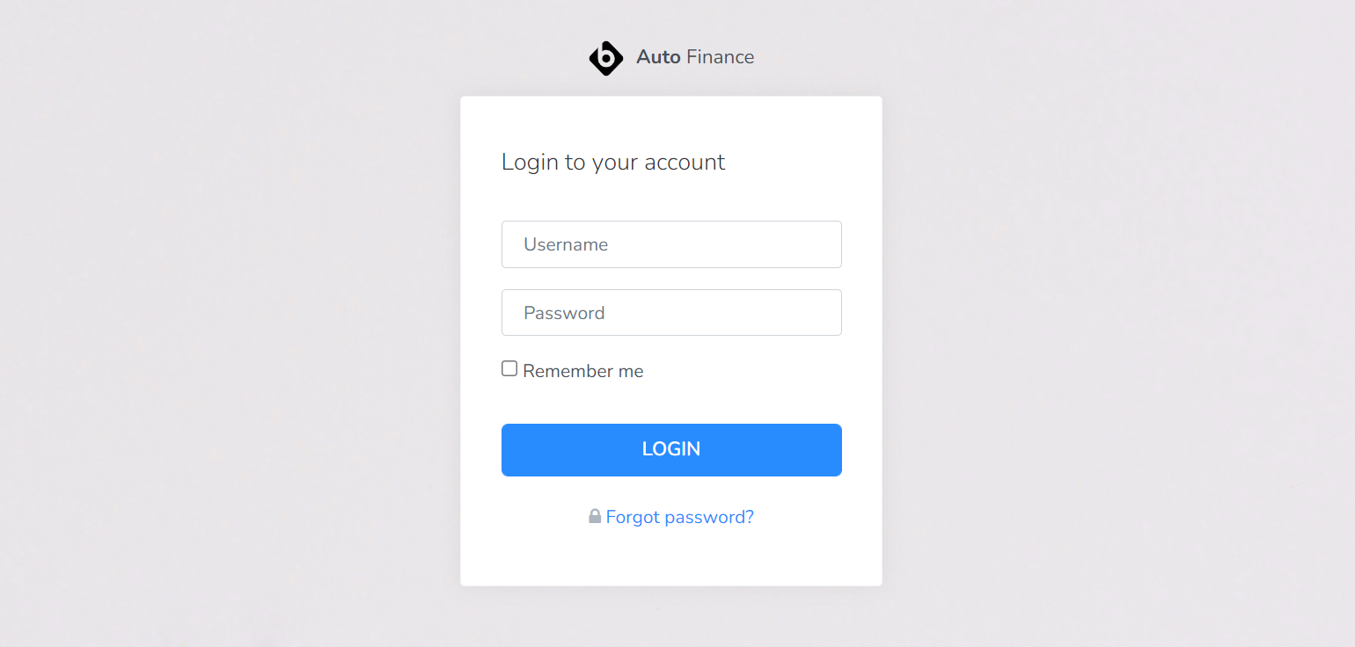
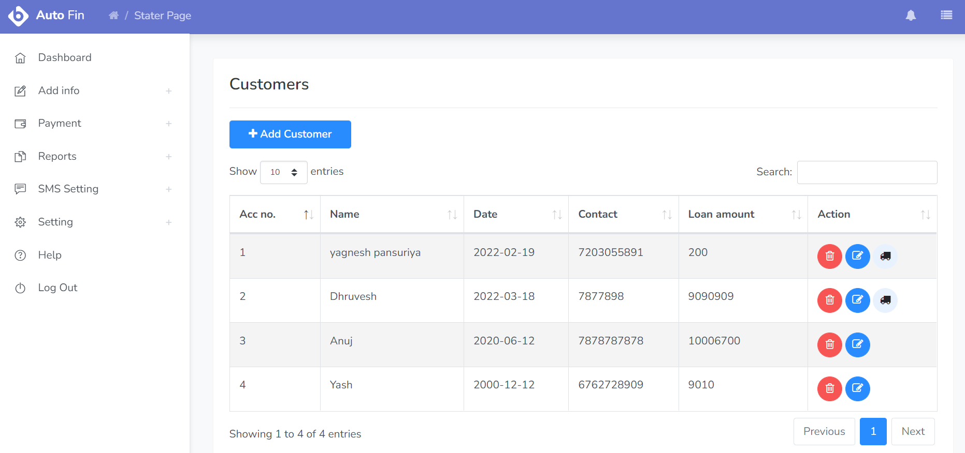
SCREENSHOTS
Customers Section :
Here Admin can see the list of all customers.
Login Page

Slide 24
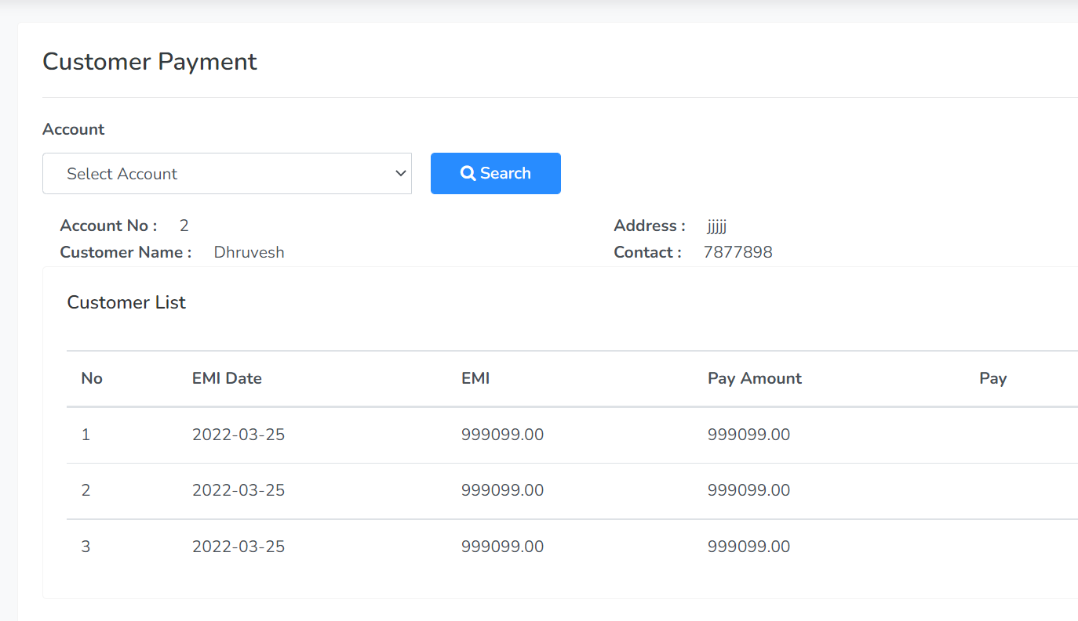
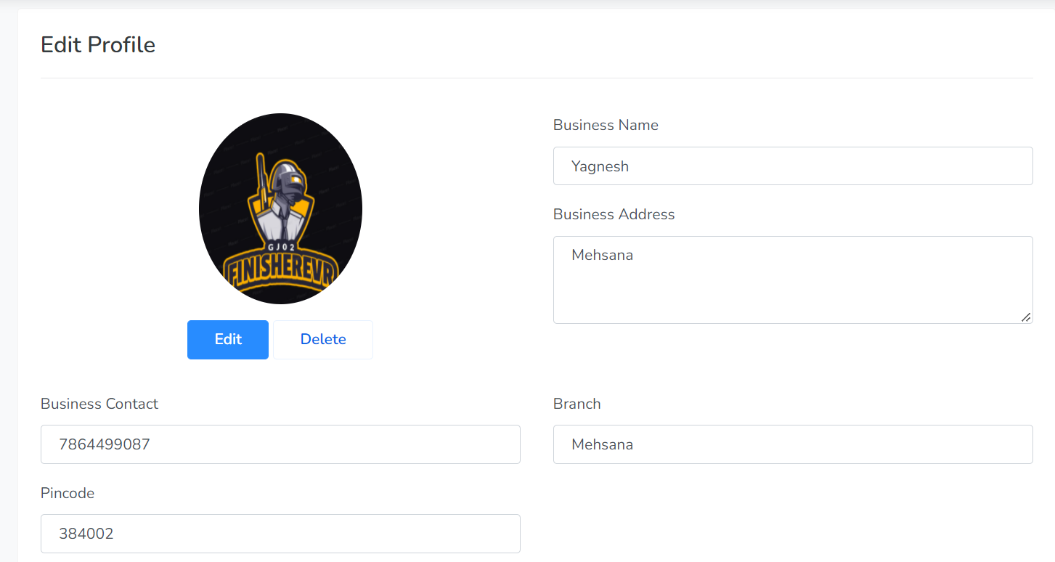
SCREENSHOTS
Edit Profile Page
Here Admin Pay the EMI of customer, which was received by customer via cheque.

Slide 25
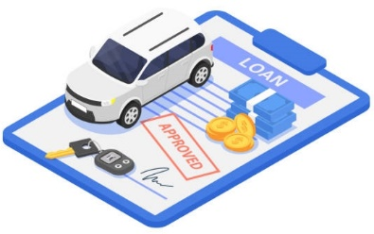

CONCLUSION AND FUTURE WORK
In Future we can develop small mini bank in that we can do anything same as the bank’s loan department works. It will be more helpful and will create a very friendly as well as sustainable environment for users to get connected to dealers and buy their dream vehicles on the go, through online as well as offline mode via this software. Moreover, we can also add personal loan section. In future, customers can view their loan details in graphical view. Also, we are planning to move our application from local database to live database so more customers can become part of our software. In addition, we can make more optimized mobile application of this web application.
Auto finance and buying new vehicles business has emerged with a new goodies compared to the past experience. Nowadays, customers can purchase vehicles through any dealers available near to them they just have to go and contact them and they will get best deals and lowest EMI rates as possible at that time and can manage their data and the loan with us very safely and securely without any hassle.

Slide 26
OUR TEAM
YAGNESH PANSURIYA
En.no- 18012011054
ANUJ PATEL
En.no-18012011060
DHRUVESH PANCHAL
En.no-18012011050

Slide 27

Do you have any questions?
Contact :
dhruveshpanchal24@gmail.com
+91 8866232023

